Slide 1

DS Mini Project
Group 12
Black Friday Sales Prediction
Presented by:
PA13 - Ritika Bhonsale
PA58 – Sanyukta Tmhankar
PA59 – Gayatri Awate
PA63 – Vaishnavi Bahirat
Guide:
Prof. Shilpa Sonawane

Slide 2
Introduction
Black Friday is a colloquial term for the Friday following Thanksgiving Day in the United States. Many stores offer highly promoted sales on Black Friday and open very early (sometimes as early as midnight), or some time on Thanksgiving Day.
Sales forecasting is the process of estimating future revenue by predicting the amount of product or services a sales unit.
Sales forecasting is the process of estimating future sales. Accurate sales forecasts enable companies to make informed business decisions and predict short-term and long-term performance.

Slide 3
Why is sales prediction & forecasting important?
A sales forecast helps every business make better business decisions. It helps in overall business planning, budgeting, and risk management.
Sales forecasting allows companies to efficiently allocate resources for future growth and manage its cash flow.
Sales forecasts help sales teams achieve their goals by identifying early warning signals in their sales pipeline and course-correct before it’s too late
Sales forecasting also helps businesses to estimate their costs and revenue accurately based on which they are able to predict their short-term and long-term performance.

Slide 4
Algorithms: Linear Regression
Linear regression is used for finding linear relationship between target and one or more predictors. There are two types of linear regression- Simple and Multiple.
Simple linear regression is useful for finding relationship between two continuous variables. One is predictor or independent variable and other is response or dependent variable. It looks for statistical relationship but not deterministic relationship. Relationship between two variables is said to be deterministic if one variable can be accurately expressed by the other.

Slide 5
Algorithms: Random Forest
Random forests or random decision forests are an ensemble learning method for classification, regression and other tasks that operates by constructing a multitude of decision trees at training time. For classification tasks, the output of the random forest is the class selected by most trees. For regression tasks, the mean or average prediction of the individual trees is returned.^{[1][2]} Random decision forests correct for decision trees' habit of overfitting to their training set.^{[3]:587–588} Random forests generally outperform decision trees, but their accuracy is lower than gradient boosted trees.

Slide 6
Algorithms: Decision Tree
A Decision Tree is an algorithm used for supervised learning problems such as classification or regression. A decision tree or a classification tree is a tree in which each internal (non-leaf) node is labeled with an input feature.
A decision tree is a decision support tool that uses a tree-like model of decisions and their possible consequences, including chance event outcomes, resource costs, and utility. It is one way to display an algorithm that only contains conditional control statements.
Decision trees are commonly used in operations research, specifically in decision analysis, to help identify a strategy most likely to reach a goal, but are also a popular tool in machine learning.

Slide 7
Advantages:
Budgeting – Companies can use predictive analytics to forecast more accurately their budgeting needs, instead of having to speculate and rely on the old models of "what-if". As a result, collaborations between departments can be improved for better team-works.
Customers’ insight– as mentioned above, advanced analytics can help businesses produce actionable customer insights predicting future actions by consumers. Companies can use this information to create better products/services tailored specifically to their customers. Similarly, companies can also apply this principle to increase the conversion rates as well as improve customers’ loyalty, reward program, and more.
Cost reduction - With the customer lifecycle becoming shorter and getting more complex, adopting predictive analytics and machine learning technology will help companies to have more effective marketing campaigns, resulting in the reduction of expenses while generating more revenue.
Gaining perspective – Business organizations can implement predictive analytics to gain insights into the future success of their new products and/or services. This is especially helpful when there is insufficient historical data available to make a forecast or when the past is not indicative of the future.

Slide 8
Disadvantages:
Time-Intensive Completion - While there are various methods of sales forecasting, the two broad approaches include manual and data-driven processes. In either case, significant time is required to develop forecasts. Within a traditional manual system, salespeople prepare their own forecasts by reviewing current accounts and overall projected sales. The time spent forecasting is less time spent selling. In more data-driven processes, a company often has marketing, IT and sales staff involved in building a system to collect and interpret data.
Expensive Technology Tools - Manual processes are not as technology-oriented, but computer tools such as spreadsheets are commonly used. Typical sales organizations will also use database software to monitor ongoing relationships with customers. As you collect and analyze data in preparing forecasts, the greater its hardware and software program requirements. Companies will pay licensing fees to software providers for access. If each salesperson has account access to use in managing relationships and preparing forecasts, the bill can get hefty for an organization.
Internal Bias - Forecasting is not always intended to be a realistic projection of anticipated sales and not a depiction of desired sales. The challenge for company marketing and sales reps in preparing forecasts is that internal bias is hard to avoid.

Slide 9
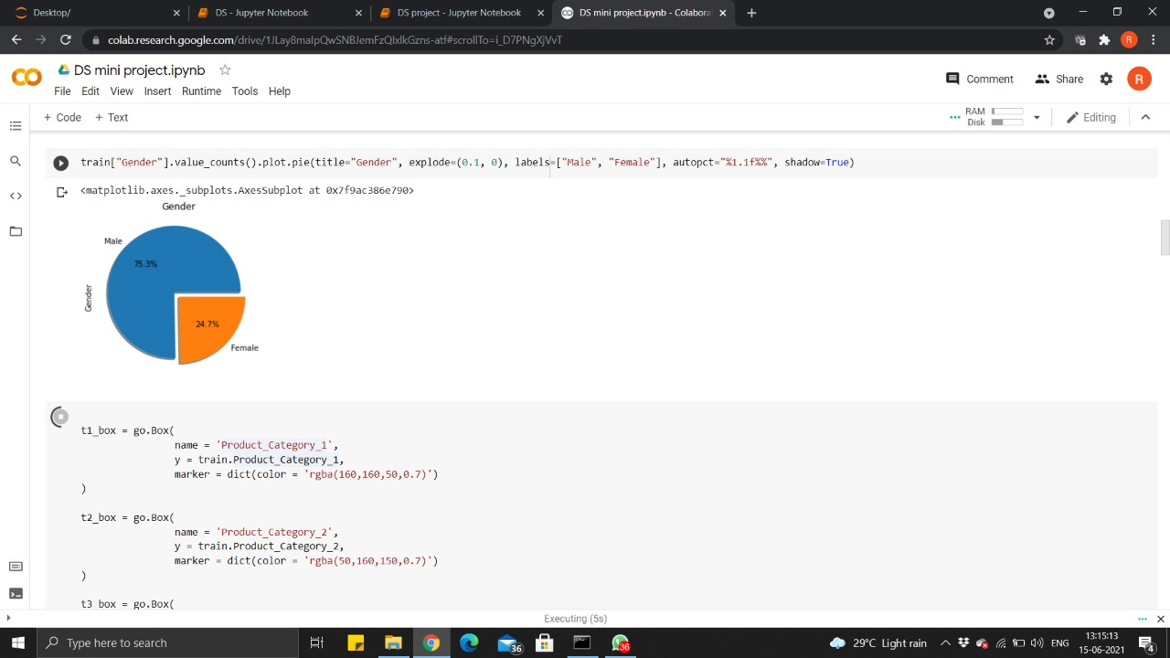
Screenshots:

Slide 10
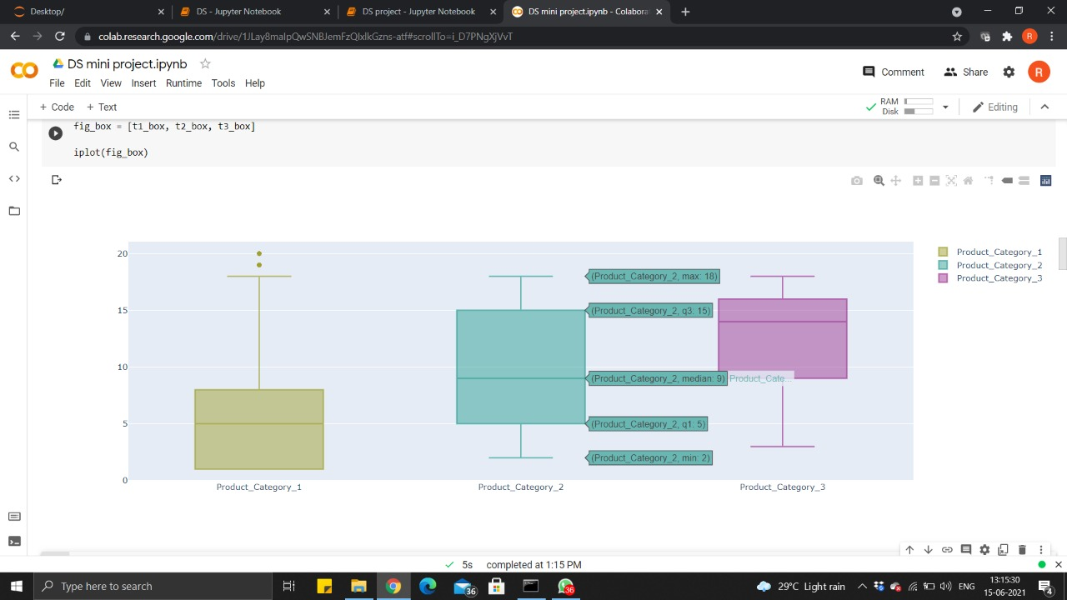

Slide 11
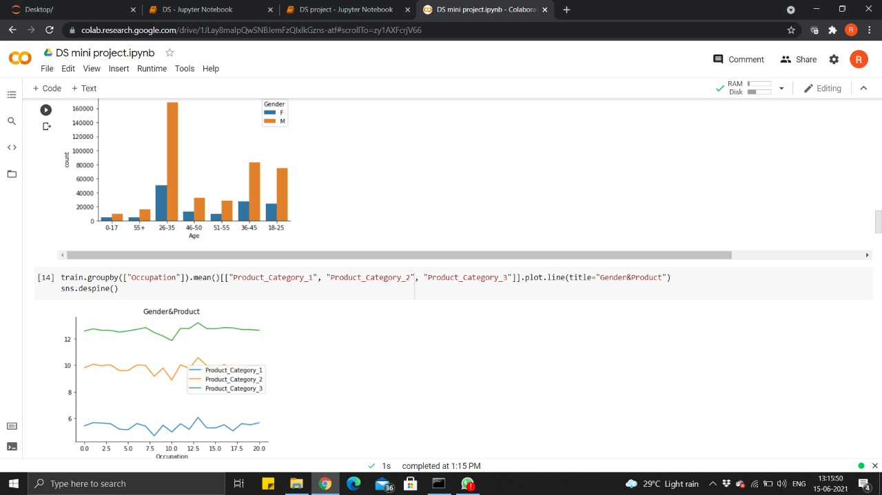

Slide 12
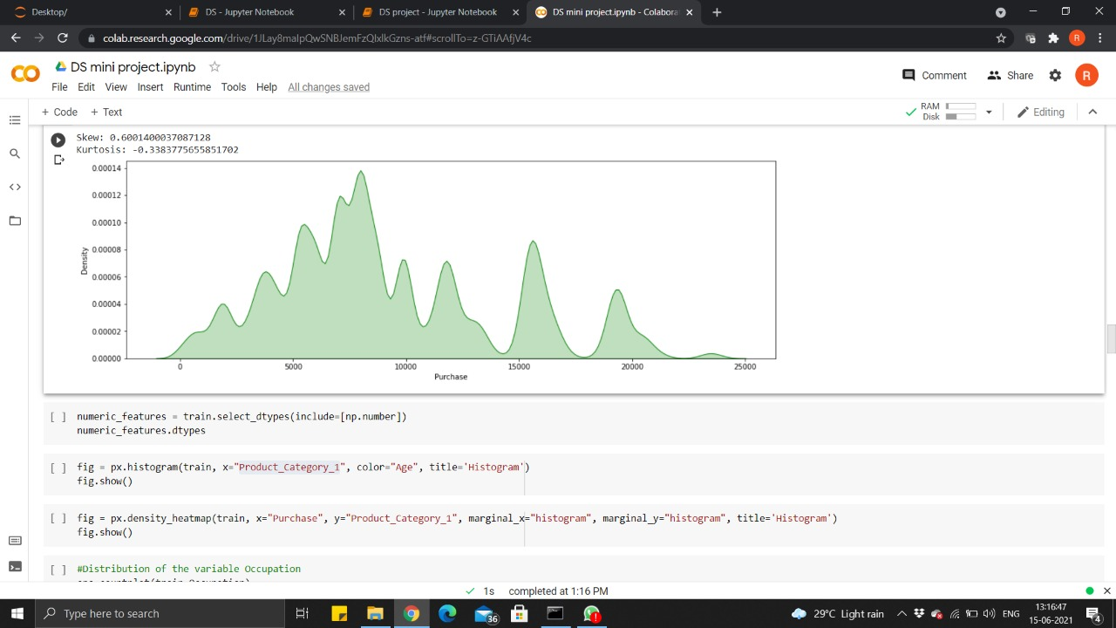

Slide 13
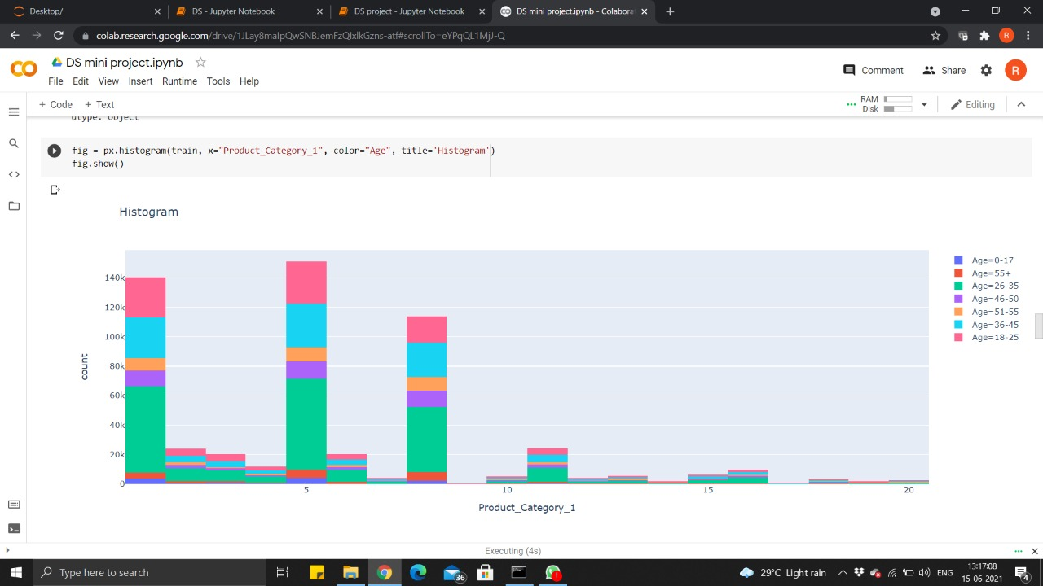

Slide 14
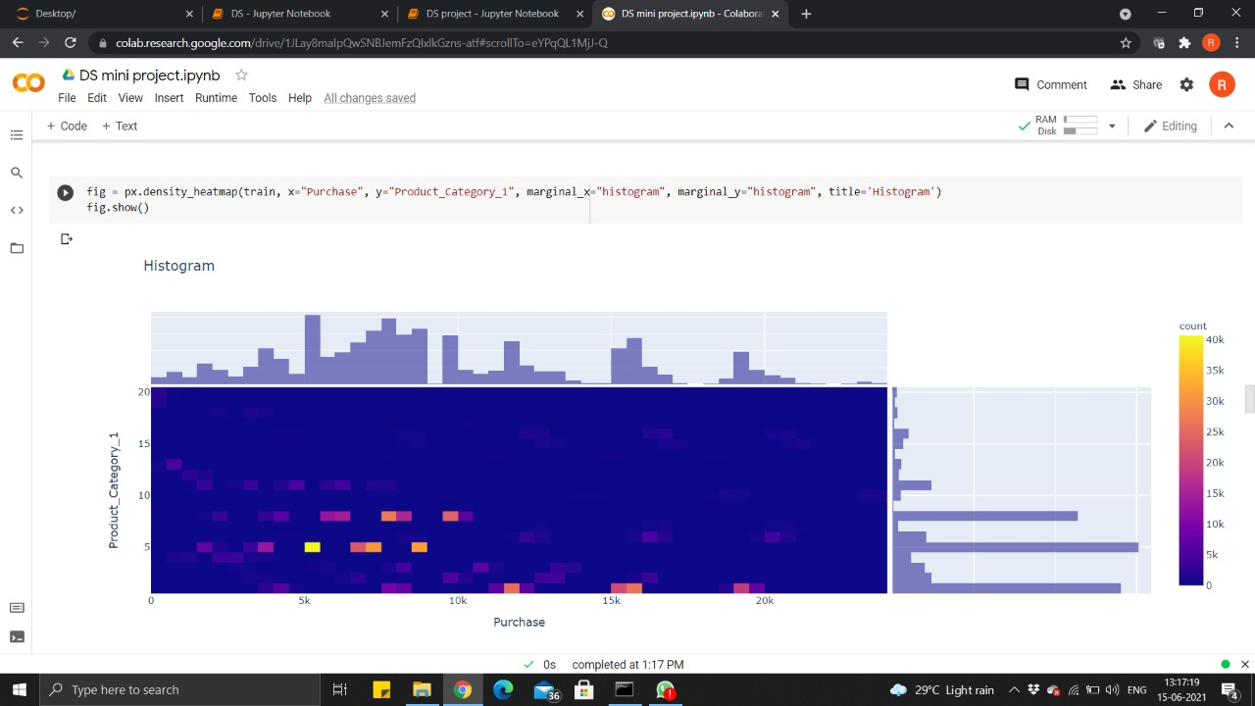

Slide 15
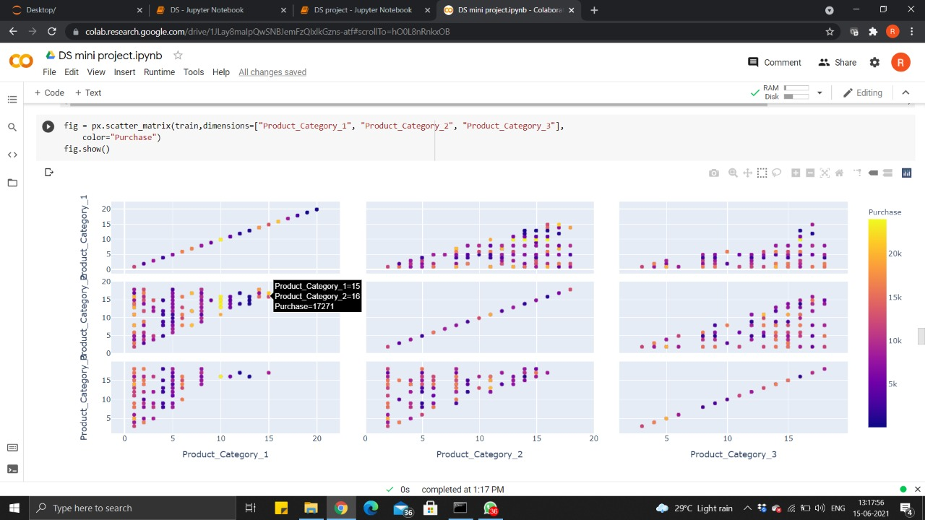

Slide 16
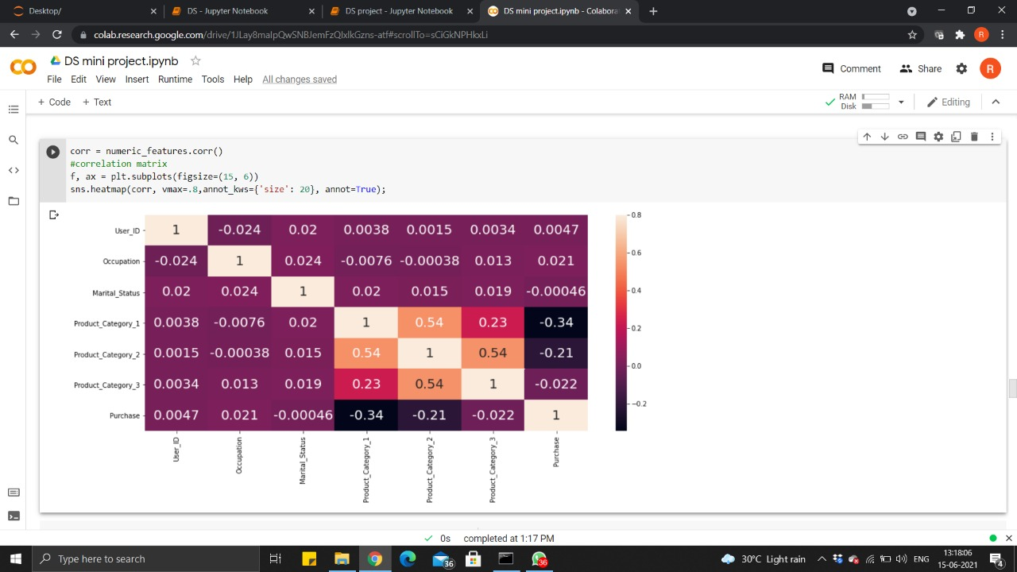

Slide 17
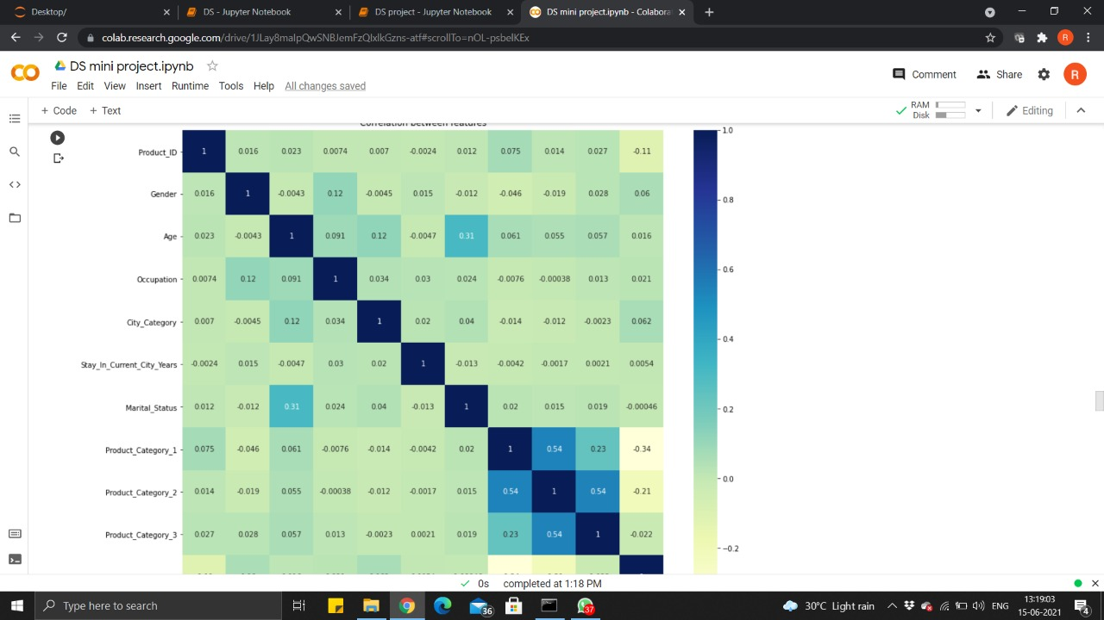

Slide 18
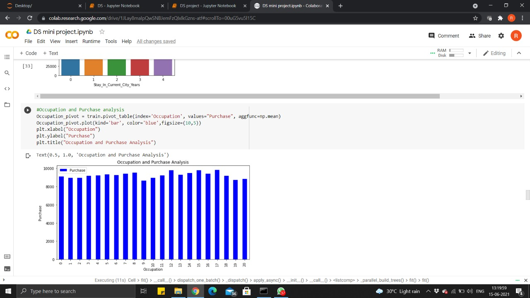

Slide 19
Conclusion:
All level participation will help companies internally assess their current business conditions, identifying the biggest weaknesses and opportunities for growth - in order to determine if predictive analytics can help to solve those business challenges and drive growth.
Sales forecasting plays a vital role in the business sector in every field. With the help of the sales forecasts, sales revenue analysis will help to get the details needed to estimate both the revenue and the income. Different types of Machine Learning techniques such as Support Vector Regression, Gradient Boosting Regression, Simple Linear Regression, and Random Forest Regression have been evaluated on food sales data to find the critical factors that influence sales to provide a solution for forecasting sales. After performing metrics such as accuracy, mean absolute error, and max error, the Random Forest Regression is found to be the appropriate algorithm according to the collected data and thus fulfilling the aim of this thesis.

